Slide 1

Notes:
1st slide (Mandatory)

Slide 2
Presentation Skills-5

Slide 3
Presentation Skills-Introduction,Body and Conclusion,use of Font,use of Colour

Slide 4

Parts of a Presentation

Slide 5
Parts of Presentation :
Introduction
Body
Conclusion

Slide 6
Introduction:
Attention Grabber
Topic and Purpose
Relevance
Agenda
Credentials
Connection
Transition
Notes:
An introduction in a presentation is the opening segment where you establish the context, purpose, and scope of your presentation to your audience. It serves as the initial connection between you and your listeners, helping them understand what to expect from your presentation and why it's relevant to them.
A well-crafted introduction typically includes the following elements:
Attention Grabber: Begin with a compelling hook or attention-grabbing statement that piques your audience's interest. This could be a surprising fact, a thought-provoking question, a relevant anecdote, or a powerful quote.
Topic and Purpose: Clearly state the topic of your presentation and the main purpose or goal you aim to achieve. This provides your audience with a roadmap for what they can anticipate from your talk.
Relevance: Explain why the topic is relevant to your audience. Highlight how it relates to their interests, needs, or challenges, and why they should invest their time in listening to your presentation.
Agenda: Provide an overview of the main points or sections you'll cover during your presentation. This helps your audience understand the structure of your talk and mentally prepare for the information you'll present.
Credentials: Briefly introduce yourself and establish your credibility to speak on the topic. Mention your qualifications, expertise, or relevant experiences that give you the authority to discuss the subject matter.
Connection: Establish a connection with your audience by acknowledging their presence and emphasizing your desire to engage with them throughout the presentation. This can create a more inclusive and participatory atmosphere.
Transition: Smoothly transition from the introduction to the main content of your presentation. Signal that you're moving from the introductory phase to the core of your talk.
Remember that an effective introduction should be concise, engaging, and tailored to your audience. It sets the tone for the rest of your presentation and helps establish a strong rapport with your listeners.

Slide 7
Effective ways of Introduction:
Few Points to consider:
Ask a question. (This is probably the easiest but least creative choice)
Share a fascinating fact or startling statistic.
Quote someone.
Share a personal story. (This is often good for speeches.)
Show a completed product.

Slide 8
Show an unusual object.
State a problem.
Wear a mask or costume.
Sing, dance, or do a skit. (Be sure it doesn’t last too long and don’t be silly.)
Enter in an unusual way such as popping up from behind the table.
Demonstrate an action without speaking.
Notes:
The best introductions are those that are creative and original, so use your imagination! After this attention-getter, you need to introduce yourself, usually just with your name, your club, and your year in 4-H. If you are giving a team presentation, you may introduce each other or each of you can each introduce yourself. Sometimes, it may even work for one person to introduce both of you.
Finally, you need to state what your presentation will be about including the major points you will cover. In some cases you might want to include why you selected this topic or what you hope the audience will learn. And it’s always nice if something in your introduction relates to your title. It should be noted that these guidelines are suggestions only. You may speak in situations where someone else introduces you or your topic may lend itself to a different order. In such cases, adapt your introduction to fit the circumstance. The introduction has to accomplish a lot, but it needs to be brief so that there is plenty of time for the main part of the presentation. An introduction over a minute or two is probably too long. When your introduction is finished, you need to make a smooth transition into the body of your talk.

Slide 9
Main Body:
Introduction to the Main Points
Main Points and Supporting Details
Logical Flow
Use of Visual Aids
Story telling
Data statistics
Address counter arguments
Notes:
The content body in a presentation refers to the main portion of your presentation where you provide the information, details, arguments, and supporting points that convey your message or topic to the audience. It's the heart of your presentation and is where you'll present your main ideas, evidence, examples, and data to support your message.
Here's how you can structure and organize the content body of your presentation:
Introduction to the Main Points: Begin by introducing the main points or topics you'll be discussing in your presentation. This gives your audience an overview of what to expect and helps them follow your presentation more easily.
Main Points and Supporting Details: Each main point or topic you introduce should be followed by supporting details, evidence, examples, and data that strengthen your argument or message. You can use bullet points, visuals (such as charts, graphs, and images), and text to convey this information effectively.
Logical Flow: Ensure a logical and coherent flow between your main points. Each point should naturally lead to the next, creating a smooth transition that your audience can follow easily.
Use of Visual Aids: Visual aids can enhance your content body by making complex information more understandable and engaging. Use visuals to illustrate key concepts, show trends, or provide comparisons. Just be sure that your visuals are clear and directly relate to the points you're discussing.
Storytelling: Incorporate storytelling techniques to make your content more relatable and memorable. Personal anecdotes, case studies, and real-world examples can bring your points to life and help your audience connect with your message.
Data and Statistics: If relevant, include data, statistics, and research findings to support your points. Make sure the data is reliable and presented in a way that's easy to understand.
Address Counterarguments: If there are potential counterarguments to your points, it's a good idea to address them within your content body. This shows your audience that you've considered different perspectives and strengthens your overall argument.
Summaries and Transitions: Periodically summarize the key points you've discussed before moving on to the next topic. This helps reinforce important information and guides your audience through your presentation.
Time Management: Keep track of time to ensure that you cover all your main points without rushing through them. If you have a limited time for your presentation, prioritize the most important information.
Audience Engagement: Engage your audience by asking questions, using rhetorical devices, or incorporating interactive elements. This keeps them actively involved and attentive.
Conclusion and Transition: As you conclude your content body, transition smoothly to your conclusion. Summarize the main points you've discussed and lead into your concluding remarks or call to action.
Remember, an effective content body is the backbone of a successful presentation. It should be well-organized, clear, and impactful in conveying your message and keeping your audience engaged.

Slide 10
Conclusion:
Summarize Main Points
Restate the Purpose
Highlight Key Takeaways
Reinforce the Message
Call to Action (if applicable)
End with Impact
Open for Questions
Body Language and Tone
Notes:
The conclusion of a presentation is a critical part where you wrap up your key points, reinforce your main message, and leave a lasting impression on your audience. Here's a structure and some tips to consider when crafting your conclusion:
Summarize Main Points: Briefly recap the main points you've covered in your presentation. This serves as a reminder for your audience and helps tie everything together.
Restate the Purpose: Remind your audience of the main goal or purpose of your presentation. Explain how you've addressed this purpose throughout your talk.
Highlight Key Takeaways: Emphasize the most important insights or lessons you want your audience to remember. These could be solutions to problems, innovative ideas, or actionable steps.
Reinforce the Message: Reiterate your central message or thesis statement. This helps to reinforce your key argument and ensures it's the last thing your audience hears.
Call to Action (if applicable): If your presentation requires the audience to take specific actions, clearly state what you want them to do next. This could be signing up for something, adopting a new approach, or exploring further resources.
End with Impact: Craft a memorable closing statement that leaves a strong impression. This could be a thought-provoking quote, a powerful anecdote, or a visionary statement that inspires your audience.
Open for Questions: If appropriate, invite the audience to ask questions or provide comments. This can engage them further and foster discussion.
Body Language and Tone: Maintain a positive and confident tone while concluding your presentation. Make eye contact, stand tall, and speak clearly to convey your enthusiasm and professionalism.
Remember that your conclusion is your last chance to make a lasting impact, so make it count. Keep it concise and focused, and avoid introducing new information that might confuse your audience. Instead, reinforce what you've already presented and leave your listeners with a sense of satisfaction and a clear understanding of your message.

Slide 11
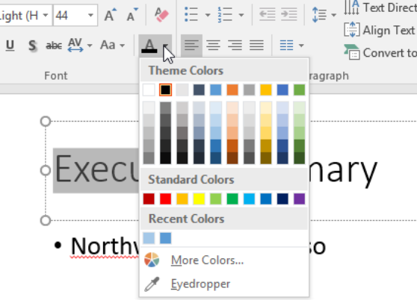
The Use Of Color In Powerpoint Presentation
Font Colours

Slide 12

Contrast
Notes:
Create contrast with PowerPoint backgrounds, graphics, text, and illustrations. Ensure a seamless blend for consistency. When using premade backgrounds, you can choose ones with the colors that will fit and complement the ones in your brand identity.

Slide 13
Evoke Emotion : Use color psychology to evoke emotions depending on the takeaway you want your audiences to have.
Black can work well for presentations surrounding grief and luxury. It is mournful, solemn, and formal.
White is neutral, making it a popular option for most people when working on PowerPoint presentations.

Slide 14
Blue brings out feelings of tranquility, security, and Peace. This is also commonly used by tech brands.
Green is interactive, warm, and works well for nature and environmental issues.
Orange is warm and flamboyant.
Yellow brings feelings of happiness and optimism.

Slide 15
Red is a tricky color; it brings out passion, but please understand the audience well. Some cultures have negative connotations to the color red.
You want to be careful about certain color combinations. Red and green, for example, can make your slides look busy.

Slide 16
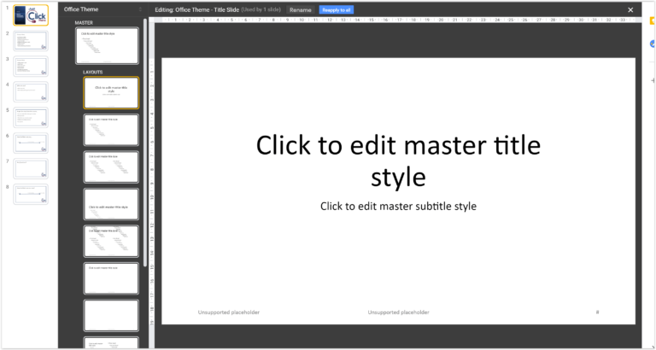
Choosing The Right Fonts For Powerpoint Presentation
Notes:
A key determining factor when choosing your font is readability. Audiences should not struggle when trying to make out the text. Pay attention to the following:

Slide 17
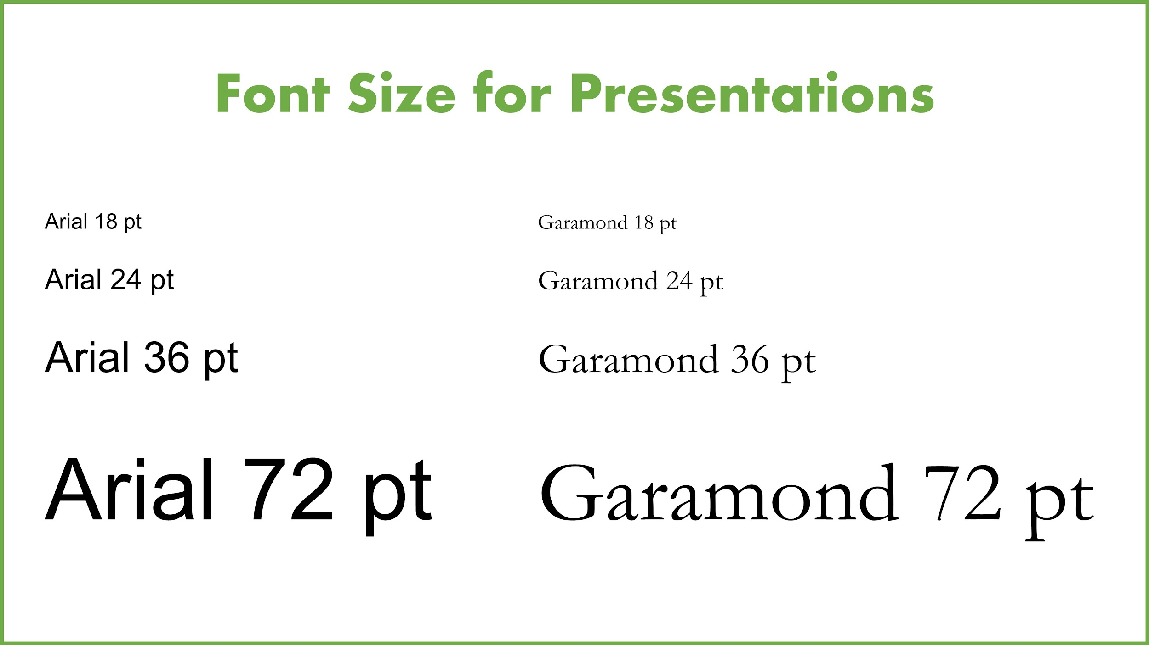
Font Size
Notes:
Font size for presentations should typically range from 24 to 30. Anything smaller and people at the back of the room will not be able to make it out.
It helps if you know the size of the screen you will be making the presentation on.

Slide 18
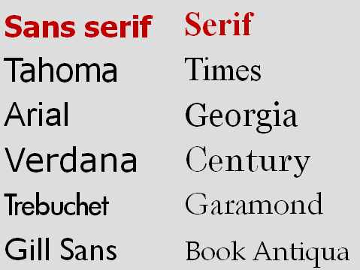
Font Type
Notes:
The audience you are presenting to determine the type of font you choose.
Top-level executives and other professionals require more 'serious' or professional fonts. Go for Times New Roman and Arial.
Younger audiences are less rigid, giving you more flexibility with the more 'fun' fonts. For them, you can use Serif, Script, and Sans Serif. Other fonts to consider are Verdana, Palatino, Calibri, and Tahoma.

Slide 19
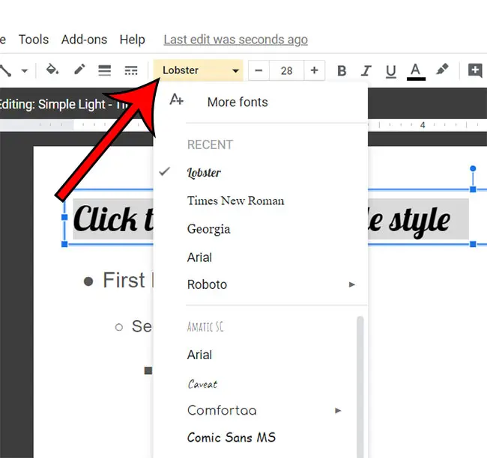
No.of fonts
Notes:
Do not exceed more than three types of fonts in your presentation. If possible, stick to two. One should be for the titles/headers and the other for the main body. Your presentation will end up looking cohesive, with a good flow.
Whatever you pick must adhere to the readability rule. These include size, contrast with the background, and type.
Your presentation may not be the best time to show how creative you can be. It ends up distracting the audience depending on the kind of font you choose. Leave the stylish or decorative fonts for birthdays and wedding invitations.

Slide 20
THANK YOU

